Slide 1


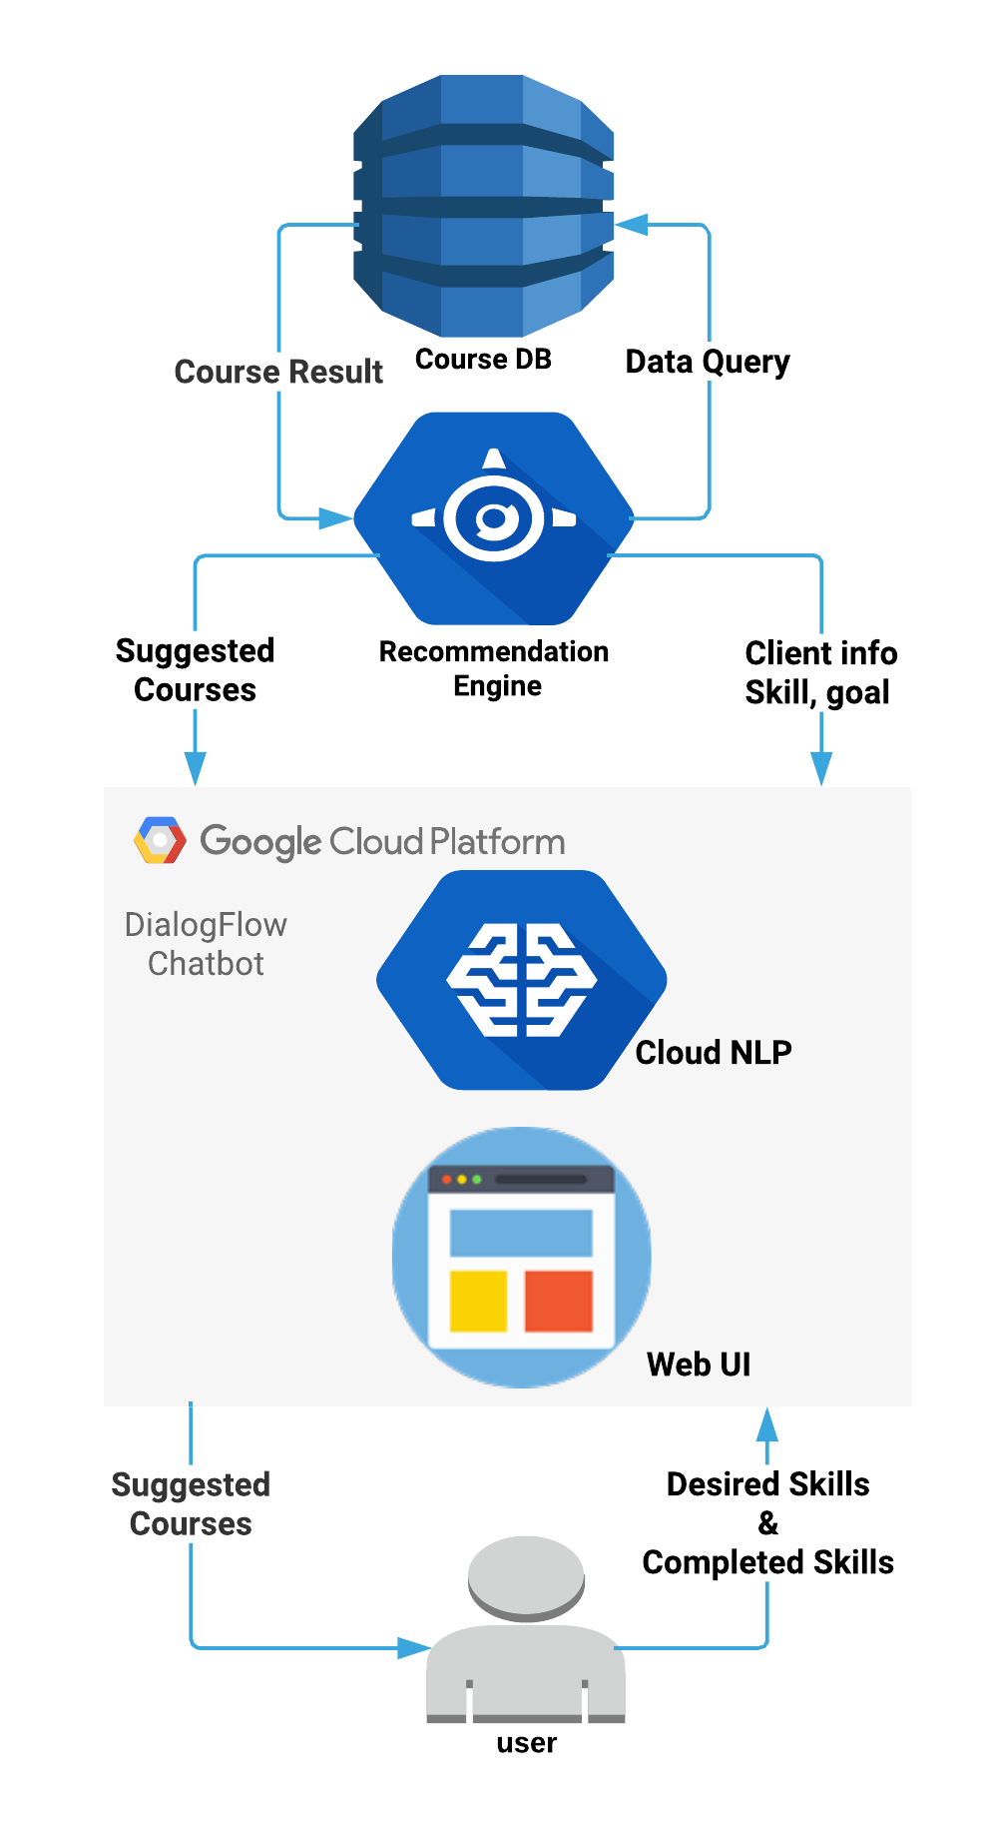
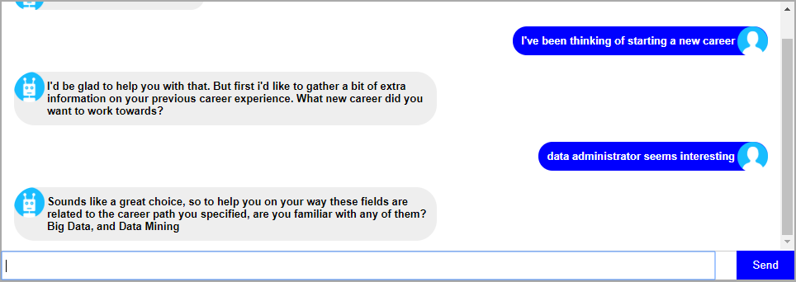
Metrics
5/6 Sponsor set deliverables were met
Deliverable 6 - Foundation has been implemented for adaptive learning and smarter features
Functional expectations were met:
Chatbot is able to effectively communicate with user and provide course recommendations
Internal group milestones were completed on a 3 week basis
Summary
The chatbot can accept several variations of responses from the user in regards to obtaining a recommendation of courses, limited only by the training data given to it.
Passed user queries then have important keywords extracted and the statement’s intent is matched to those created by our team. This information is then passed onto our Recommendation Engine(RE) it queries the database and provides a response based on conversation context changes, to satisfy the user’s request.
The database is accessed through the RE and contains information about various careers. It also contains specific information such as skill/tools required for a job, relevant courses for each skill/tool, and details of employee experience
Learning & Development Advisor Part II
CS 4485 / Fall 2019
Department of Computer Science
Erik Jonsson School of Engineering & Computer Science
The University of Texas at Dallas
Richardson, TX 75080, USA
Faculty Advisor Prof. Ebru Cankaya
Jesse Cacique
jxc121631@utdallas.edu
Mukul Modi mgm130130@utdallas.edu
Vafa Tebyanian
vxt162830@utdallas.edu
Maryam Aleyasin Mxa156830@utdallas.edu
In order to better facilitate internal growth and development of, ATOS is looking to better equip their employees with the right tools and skills to advance their careers. The purpose of the project was to develop a user-friendly chatbot that would recommend courses for user’s career goals. This was accomplished through a web framework which utilized Google’s DialogFlow Engine for language processing, a SpringBoot application which would handle requests from DialogFlow and query a mySQL database containing job and course information. This project provides a more engaging way for employees to learn ways to advance their careers and have a more positive impact on the company.
Keywords: Chatbot, AI/ML, UI/UX
Abstract
Architecture
Courses Database
Contains information about job goals, courses, and courses that correspond with each job
Provides output based on user data
Recommendation Engine (RE)
Parses user input from Chatbot Web UI
Queries the database to output course recommendations
Gives conversation response back to DialogFlow
Cloud NLP (DialogFlow)
Natural language processing for user input from web UI
Understands and provides conversation context to Recommendation Engine
Outputs response from RE to Web Interface
Web UI (Chatbot)
Main implementation through which user can interact with service
Users provide their goals, skills, and tools to the bot
Impact
This project gives users a centralized and consistent way to gain information about courses needed to fulfill their career goals
A chatbot is a much more engaging resource than tables of information, encouraging users to utilize this service more, increasing their own knowledge base.
Sample Conversation of Employee (right) looking for information on a Data Admin role

